Slide 1
Netflix through the Decade
- Drushti G.

Slide 2
Important Notes
Used scraped dataset from Kaggle
Analyze data set of Netflix Movie and TV show Titles to see what common trends have occurred over the years.
Variables : - Type, Title, Release Year, Netflix _year,Netflix_month,Duration,Rating,Country
Analyzing 10 years od data (2011-2021)
Total number of records: 7278

Slide 3
Questions answered
Distribution of movies and TV shows added every month.
Type of Content available for audiences.
Globally which countries have large number of netflix movies and tv shows streamed.
Distribution for duration of movies for Top countries
Distribution of movies change over time.
Was netflix impacted by pandemic?

Slide 4
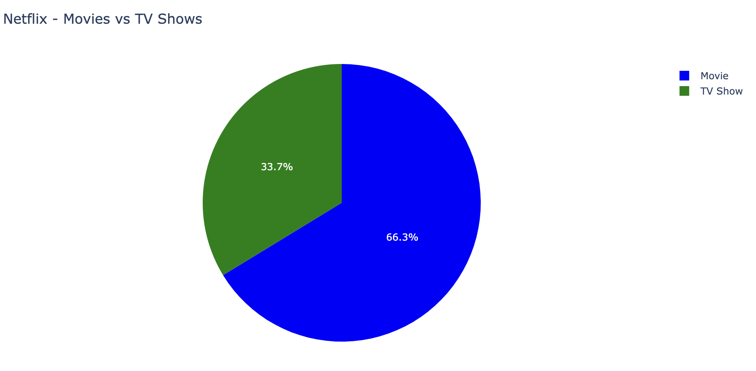
Movies vs TV Shows
Notes:
This pie chart clearly shows the movies are dominated over TV shows.

Slide 5
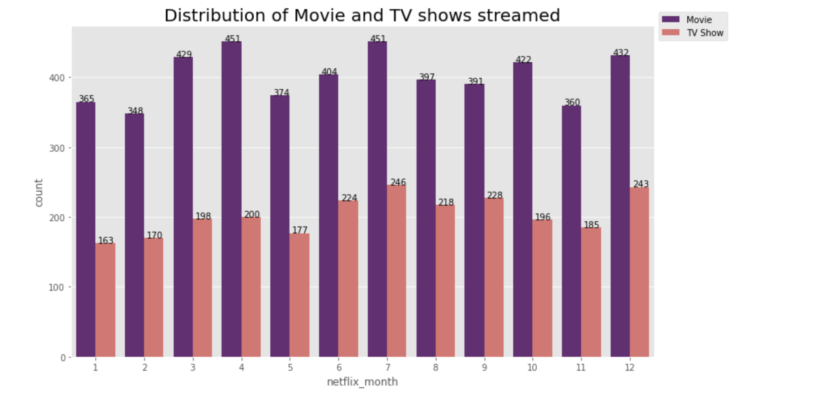
Distribution of TV Shows and Movie Streamed
Notes:
Movies - February
TV shows - May
Based on my assumption despite October and December being the Halloween and Christmas season, I observed that the maximum count for the content being added.

Slide 6
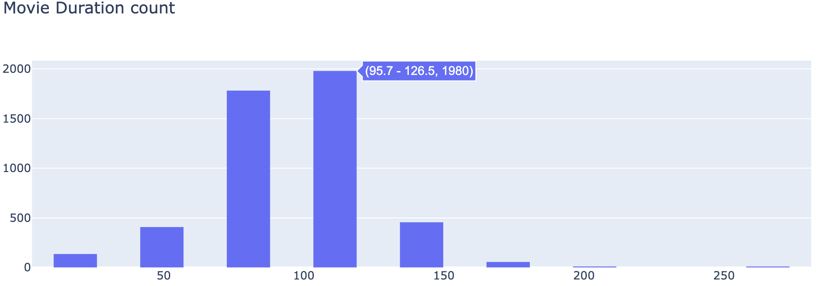
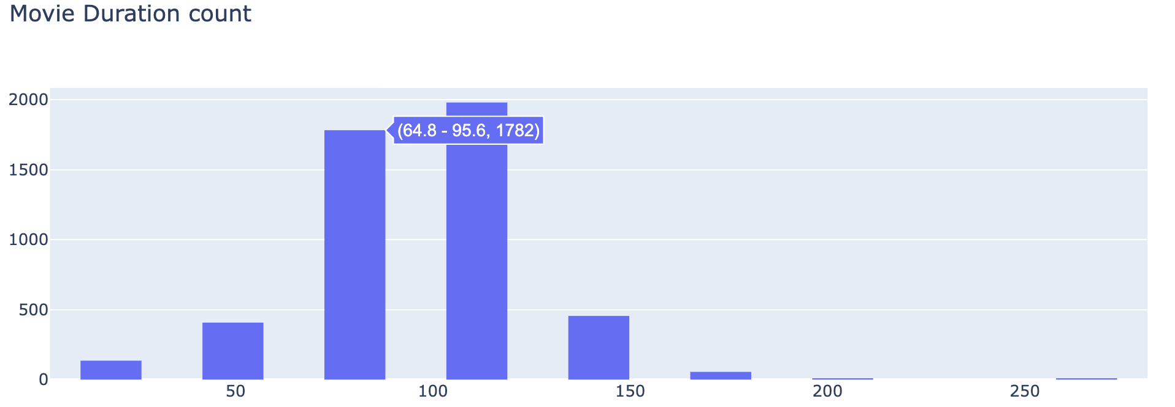
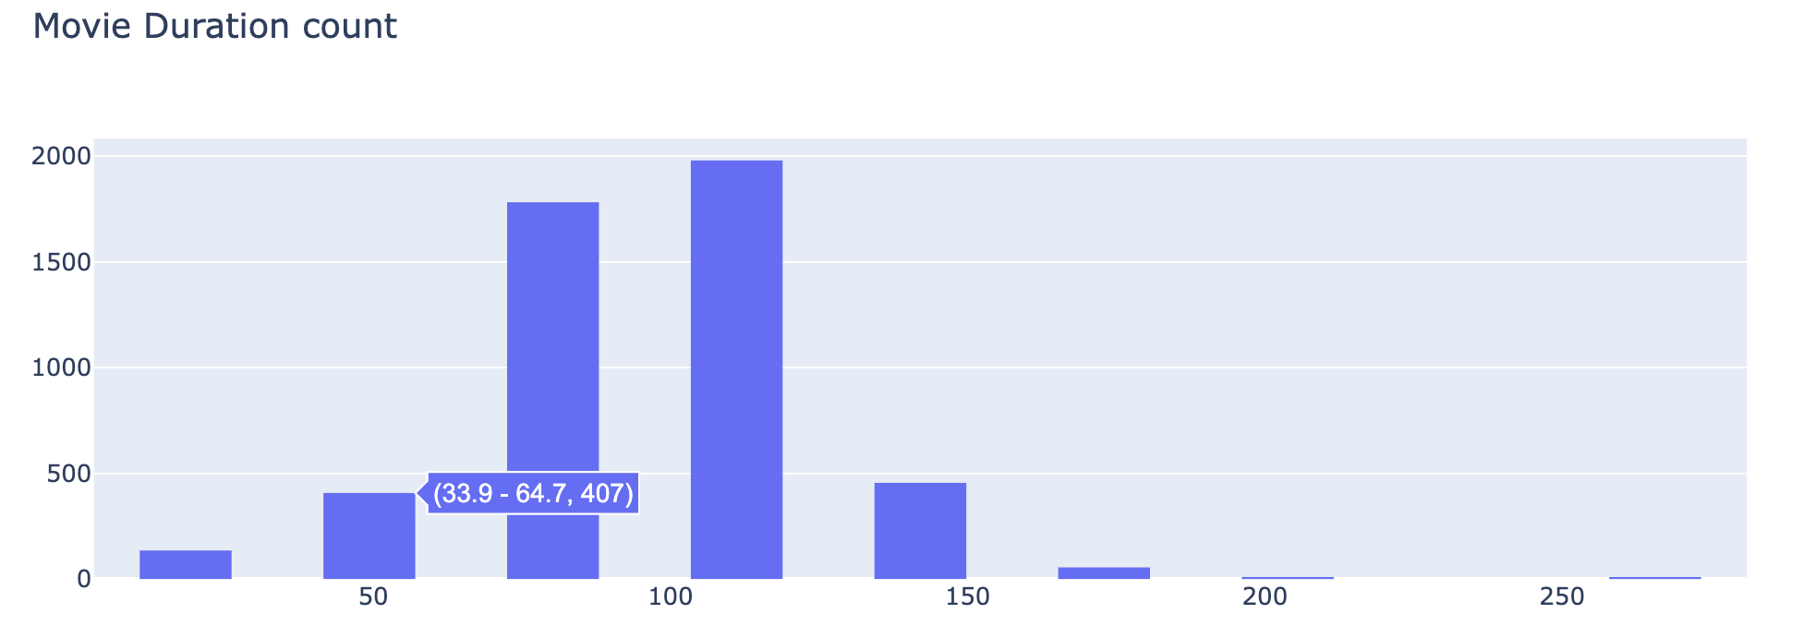
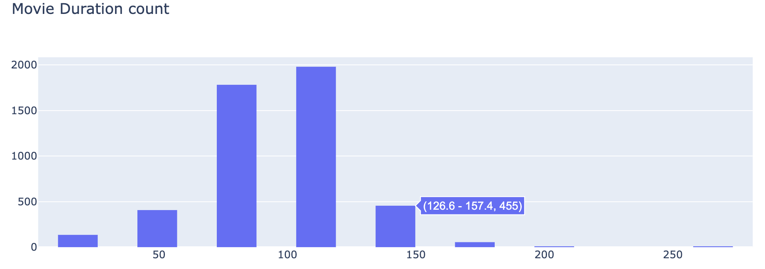
Distribution of duration for Movies
Notes:
Max distribution between 95 to 126, followed by 64 to 95.

Slide 7
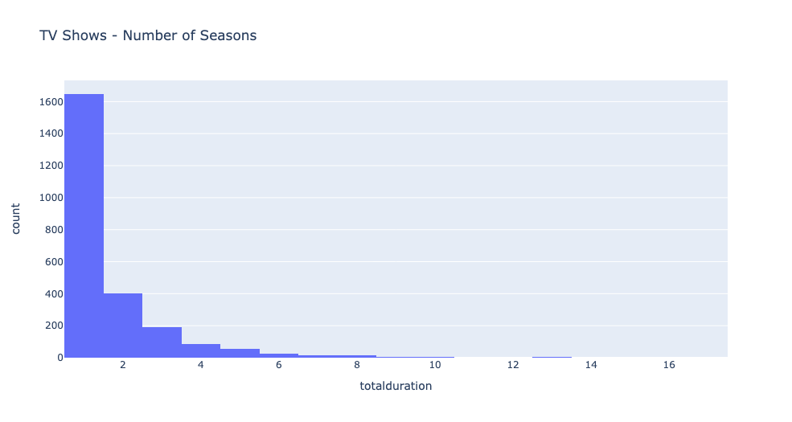
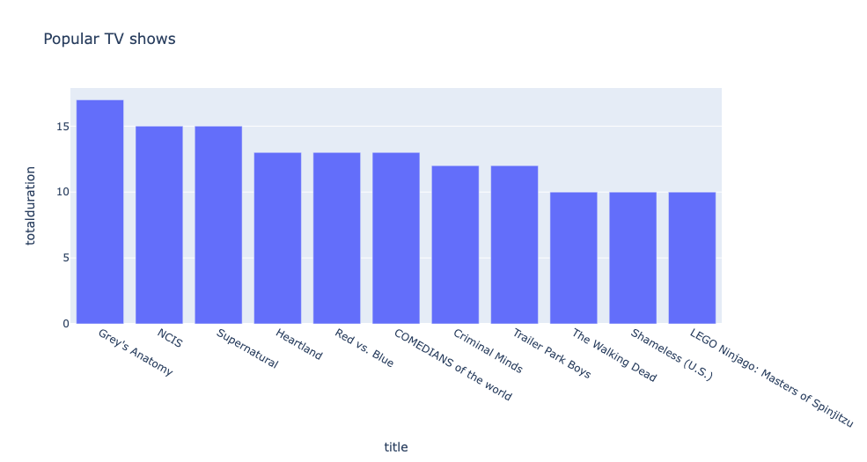
Popular Series on Netflix
Notes:
I found in this dataset the maximum number of TV shows on netflix ended up with season 1 -1600. There is a vast difference between the count in TV shows, we gradually see a steep down between season 1 and season
In contrast to this, the other graph shows the popular series on netflix with 10 or more season with Grey anatomy leading with 17 seasons.
There

Slide 8
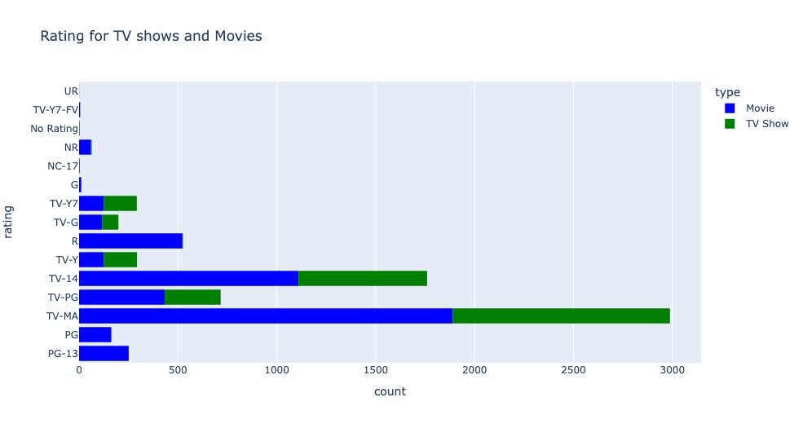
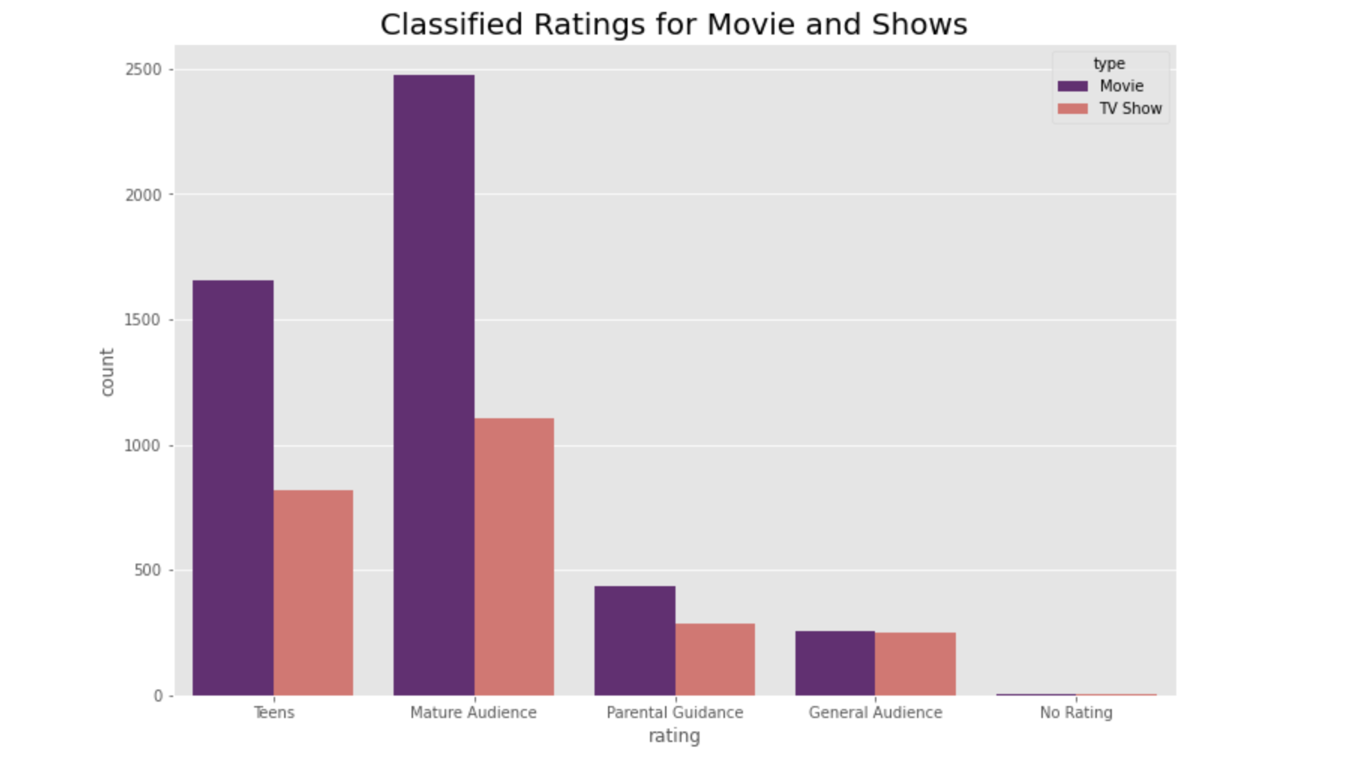
Classified Ratings for Movies and TV Shows
Notes:
This is a distribution of movies and TV shows ratings on netflix which i classified in different categories of audience.
Based on analysis I found out Netflix target audience is Mature Audience and Teens.

Slide 9
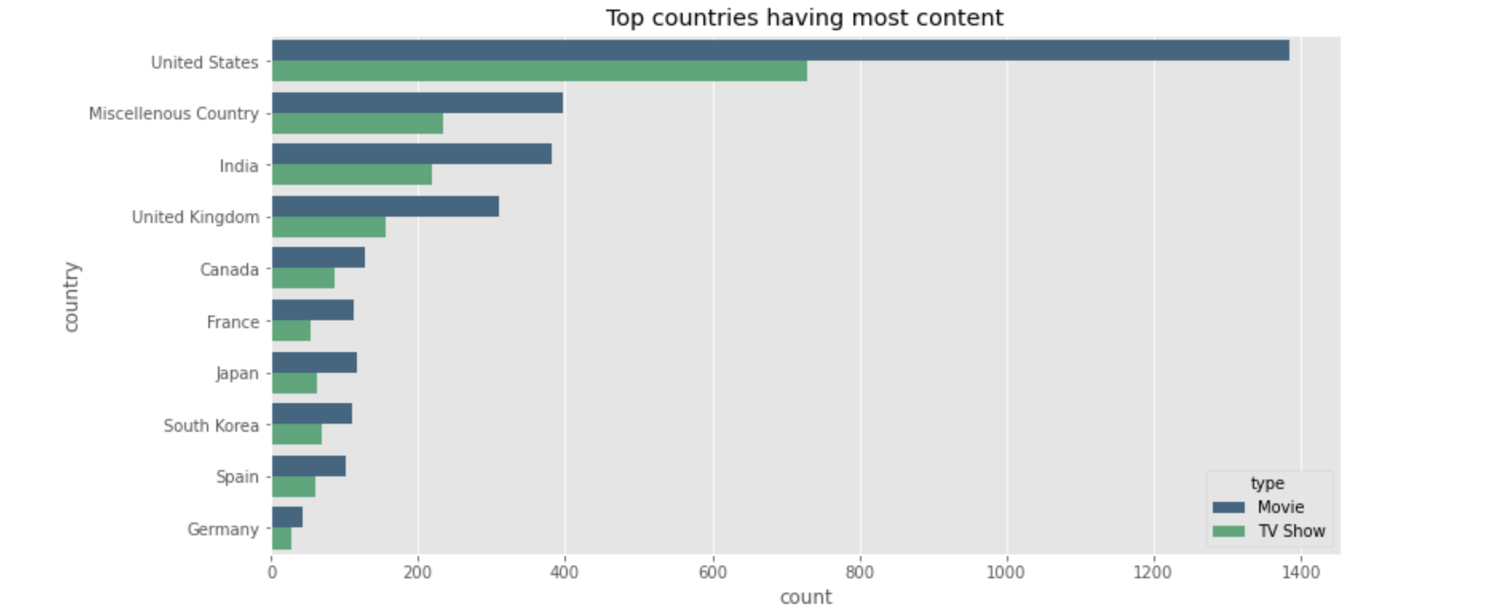
Countries with Movies and TV shows
Notes:
United States top the chart with maximum movie and shows streamed on netflix followed by India and UK. Miscellaneous country are the one where the countries weren’t mentioned for the record. The countries could be a part other countries in the world.

Slide 10
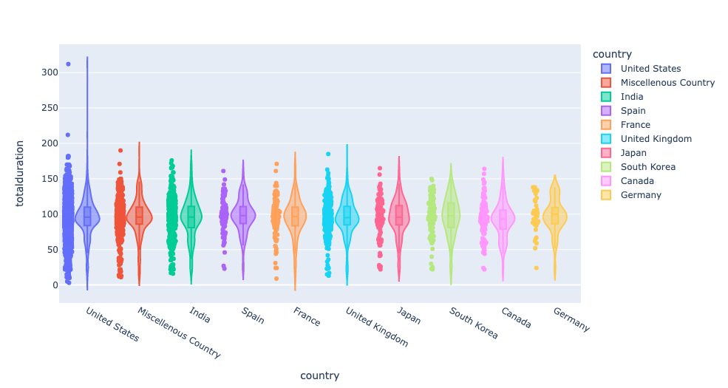
Movie Duration for Top countries
Notes:
This violin plot is a combination of box plot and kernel plot for each country.It is observed that the movie duration for the top countries is with in the for 50 percentile.

Slide 11
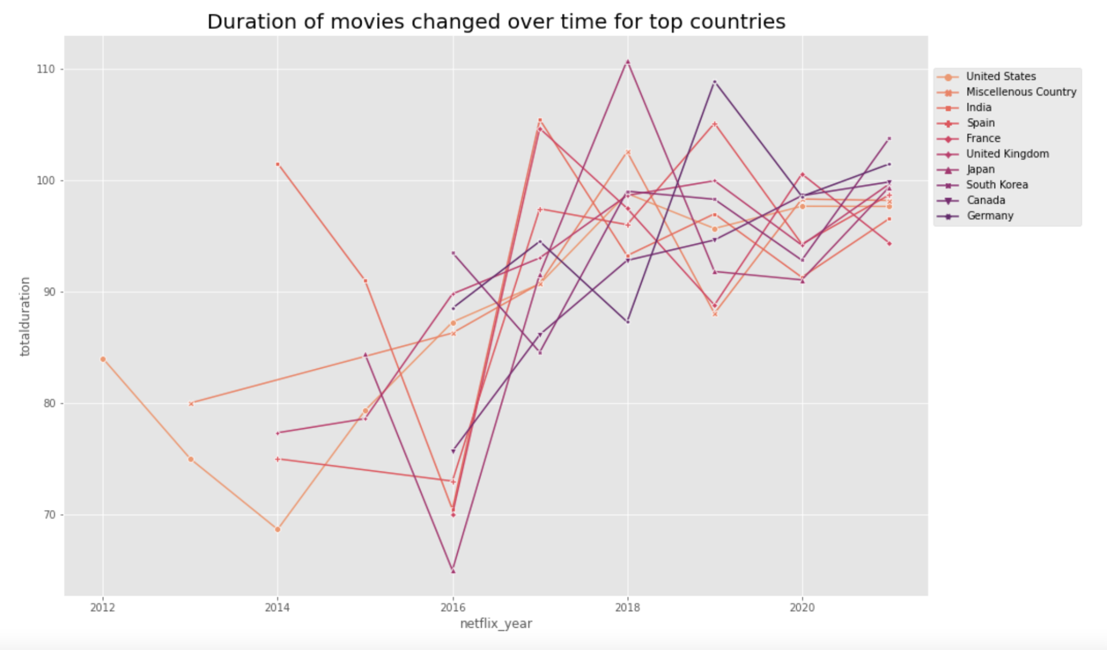
Duration of Movies change over Time
Notes:
This graph shows the movie duration time over the eight year has been different for countries but for the last two year (2020-2021) netflix has added movies with duration of 90 -110 mins i.e 1 ½ - 2 hrs

Slide 12
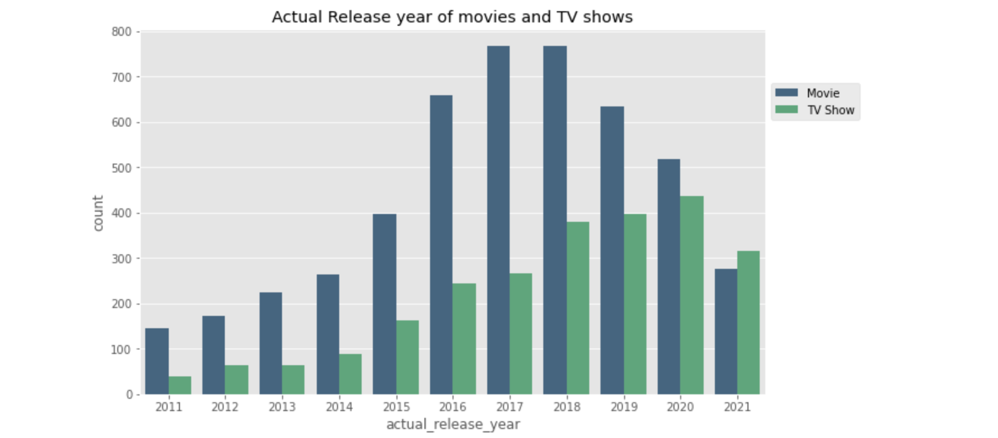
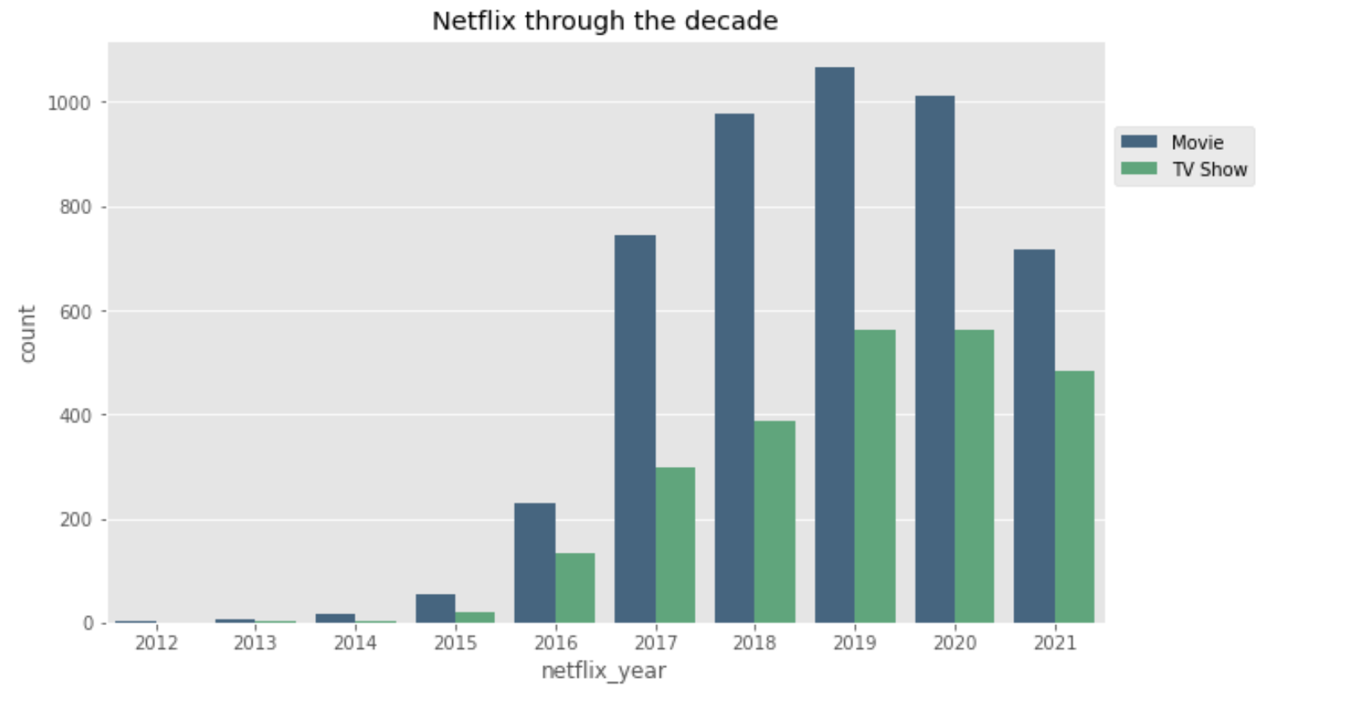
Was Netflix impacted by Pandemic?

Slide 13
Future Work
Merge with data set for TV shows with Episode, and Subscription prices for countries.
Find the average episode of TV shows per season
Did it help with increasing the number of netflix subscription by adding more content to netflix during the pandemic.

Slide 14
Thank you!

